Slide 1







Luxury Housing Sales Analysis
Bengaluru

Slide 2
Key Outcomes
Clean & structured luxury housing dataset
Automated MySQL data storage & validation
Live Power BI dashboard with business insights
Actionable findings for builders, investors, analysts
Objectives
Scale
Build an end-to-end data pipeline
Deliver actionable insights on luxury housing sales
100K+ records across projects, builders, buyers, micro-markets
Tools & Technologies
PYTHON
MYSQL
POWER BI
Data Cleaning and Feature Engineering
Centralized Data Storage
Live Dashboard & Insights

Slide 3
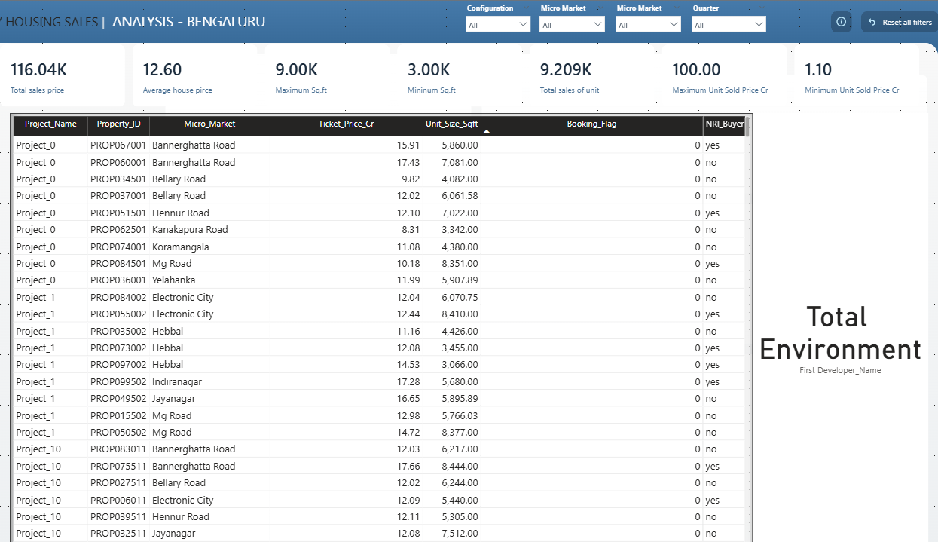
Power BI Dashboard
HOMEPAGE FEATURES
KPIs
Builder, Micro-Market, Quarter, Configurations
Drill-through pages → Detailed Builder & Micro-Market insights
Total Revenue,
Avg Price, Total Units Sold and etc
KPIs
Filters
Navigation

Slide 4
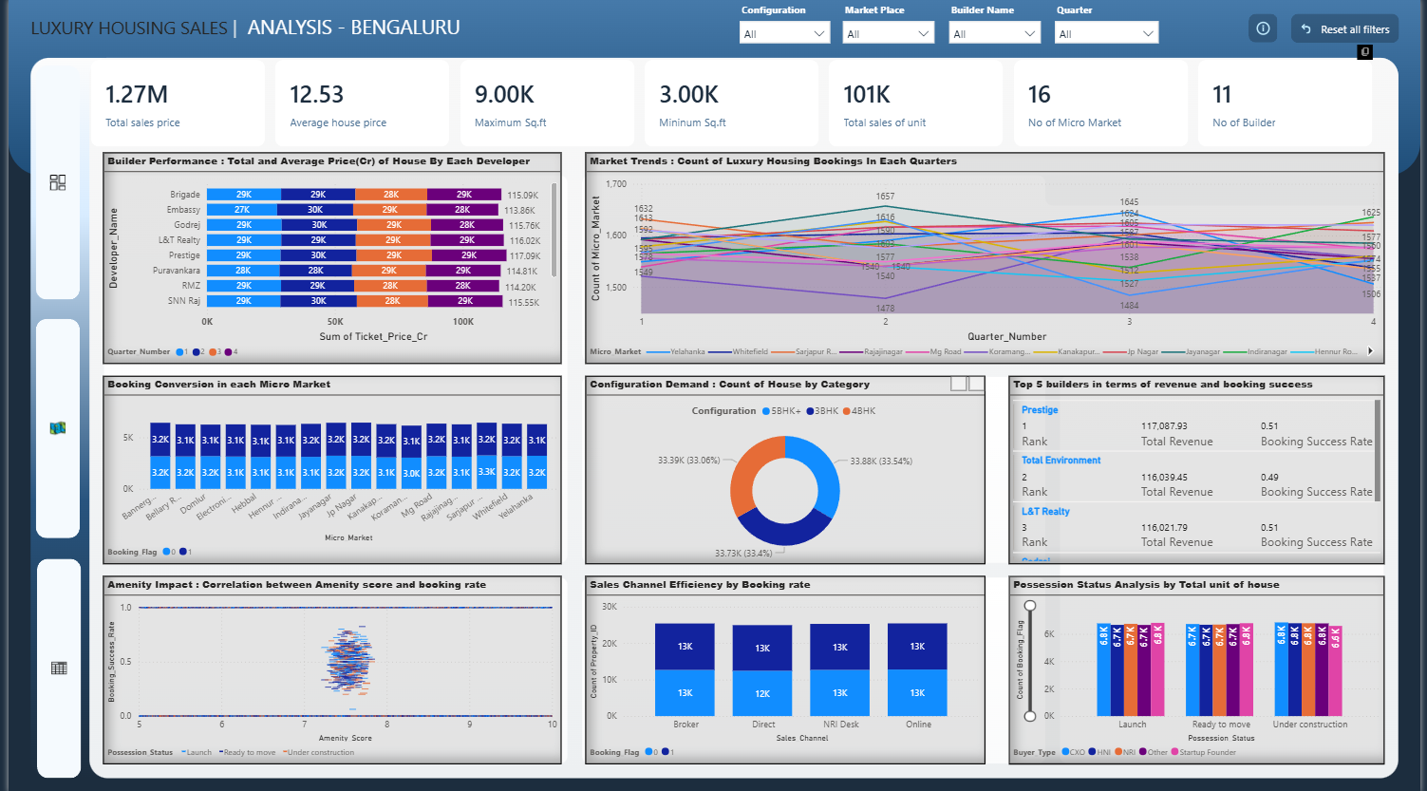
Key Charts
Market Trends, Builder Ranking, Booking Conversion, Configuration Demand, Sales Channels, Possession Status, Quarterly Builder Contribution, Geographical Insights and Top Performers

Slide 5
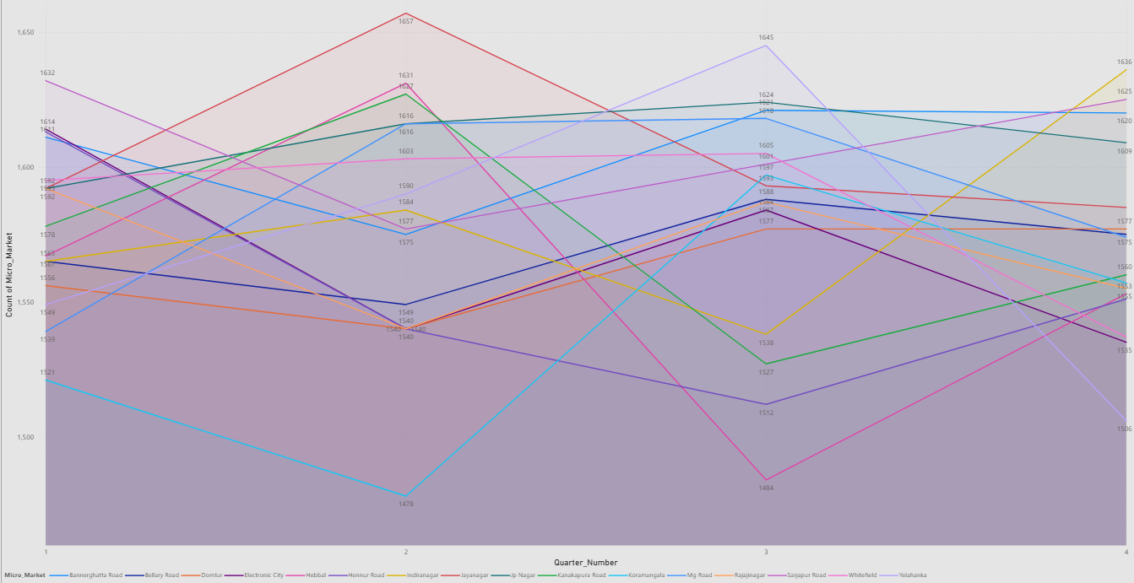
Luxury Housing Bookings Over Time
Insights
Chart : Line Chart
X axis : Quarter Number
Y axis : Count of Micro market
Legend : Micro market
Top Performer
Bottom Performer
Most Volatile
Recent Momentum
Most Stable
Jayanagar leads in overall sales volume.
Highest Total Revenue: 80,732.9Cr
Koramangala generates the lowest total revenue.
Lowest Total Revenue: 77,073.5Cr
Hebbal shows the largest quarter-over-quarter swing.
Q2 Peak (20,588.6) → Q3 Low (18,630.3)
Bannerghatta Road dominated the most recent quarter.
Highest Q4 Revenue: 20,317.9Cr
Electronic City provides the most consistent performance.
Lowest Revenue Range (≈19,400–19,900Cr)

Slide 6
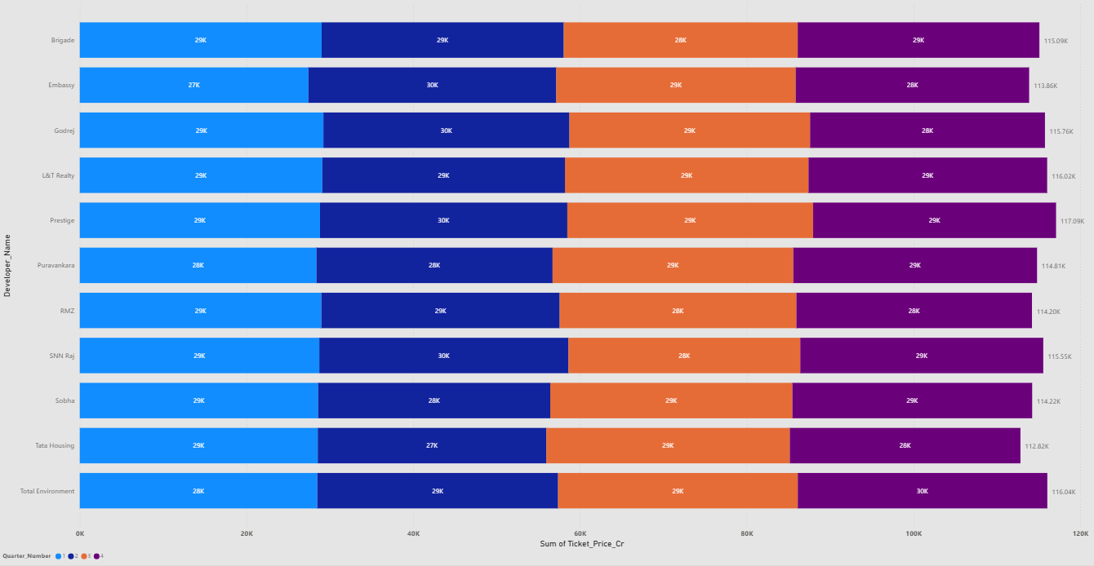
Builder Performance
Insights
Chart : Stacked Bar Chart
X axis : Sum of ticket price
Y axis : Developer Name
Legend : Quarter Number
Tool tips: Average of Ticket Price
Top Performer
Bottom Performer
Most Costly
Recent Momentum
Most Stable
Prestige
Highest overall sales revenue (117.0KCr).
Tata Housing
Lowest overall sales revenue (112.8KCr).
Sobha
Highest Average Ticket Price (focus on premium projects).
SNN Raj
Lowest Average Ticket Price
Prestige
Highly stable quarterly sales across Q1, Q2, Q3, and Q4.

Slide 7
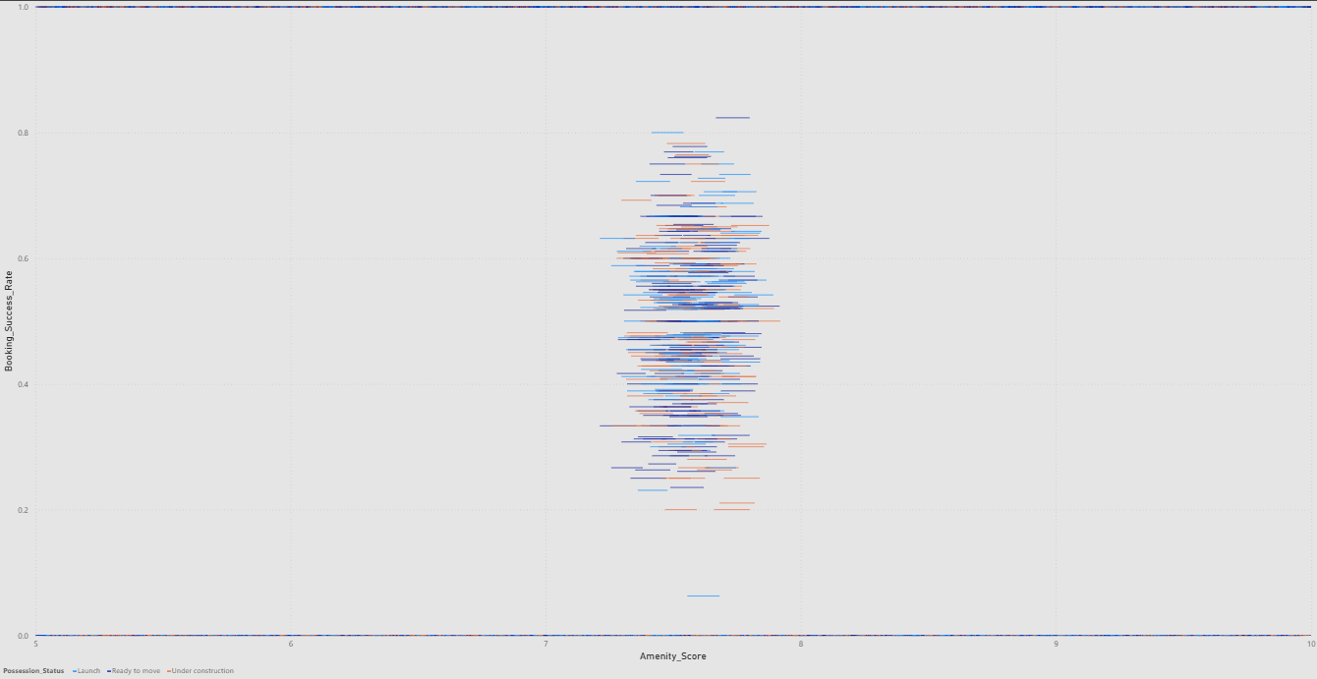
Amenity Impact
Insights
Chart : Scatter Chart
X axis : Amenity Score
Y axis : Booking success rate
Legend : Possession Status
Size : Count of Project Name
Tool tips: Total Revenue and
Count of Project Name
Success rates vary widely despite narrow amenity scores.
Suffice Top booking success occurs with mid-range scores.
No Amenity Correlation
Average Amenities

Slide 8
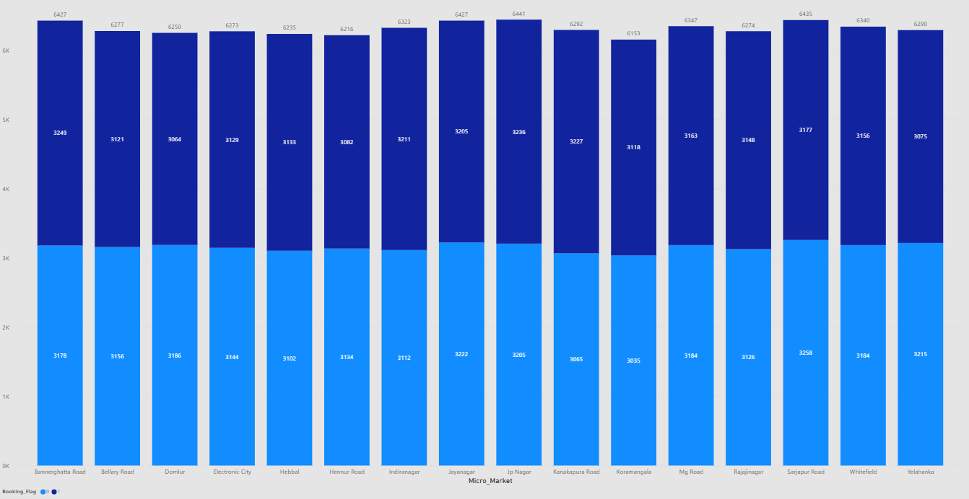
Booking Conversion
Insights
Chart : Stacked Column Chart
X axis : Micro_Market
Y axis : Count of Property_ID
Legend : booking_Flag
Tool tips: Total_Revenue
Lowest Conversion Rate
Highest Success Volume
Highest Unsuccessful Revenue
Kanakapura Road -51.29%
Most efficient at converting leads into successful bookings.
Highest Conversion Rate
Yelahanka - 48.89%
Lowest conversion efficiency, indicating the highest rate of failed transactions.
JP Nagar - 3,265 Bookings
Market generating the highest absolute number of successful bookings.
Sarjapur Road
41,717.51Cr
Highest potential revenue lost due to failed transactions (Flag=0).

Slide 9
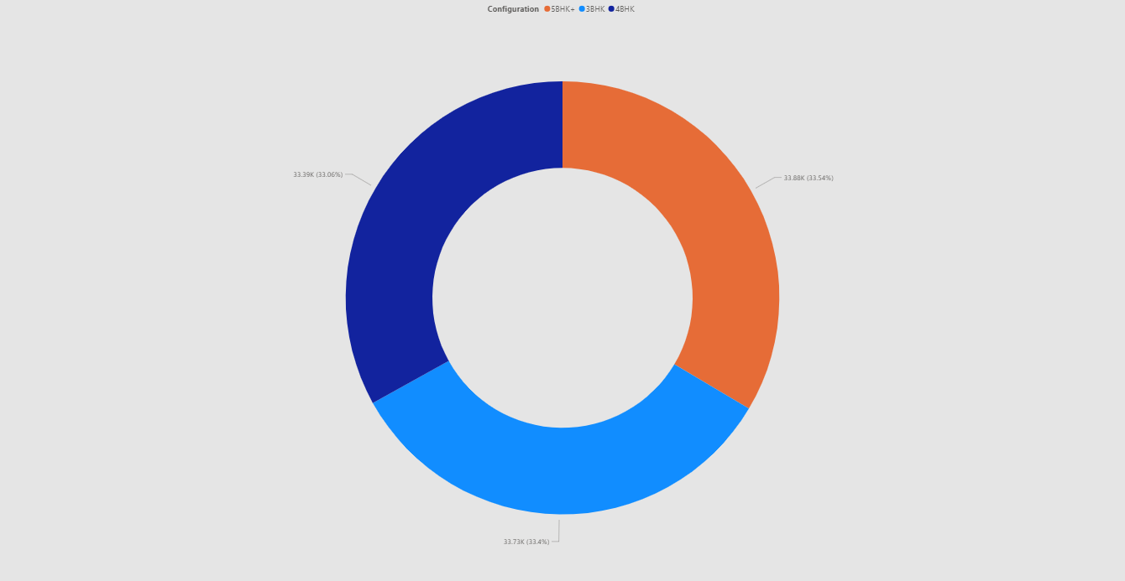
Configuration Demand
Insights
Chart : Donut Chart
Legend : booking_Flag
Value : Count of Booking_Flag
Details: Quarter_Number
Tool tips: Total_Revenue
Top Demanded
3BHK (Bright Blue)
33.73K (33,730)
33.40%
Close Second
Least Demanded
5BHK+ (Orange)
33.88K (33,880)
33.54% of configuration
4BHK (Dark Blue)
33.39K (33,390)
33.06%
Extreme Market Balance
Demand is nearly perfectly distributed across the three luxury segments (3BHK, 4BHK, 5BHK+), with each segment accounting for roughly one-third of the market.

Slide 10
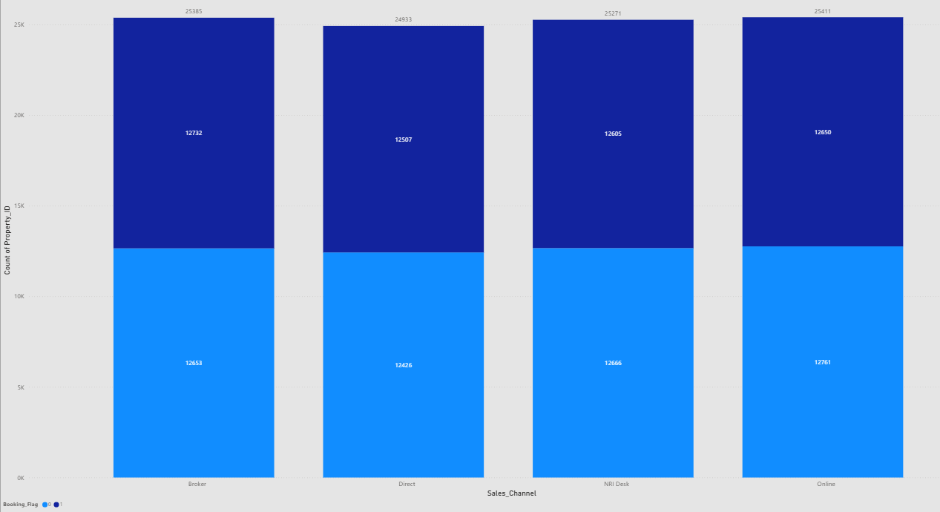
Sales Channel Efficiency
Insights
Chart : Stacked Column Chart
X axis : Sales_Channel
Y axis : Count of Property_ID
Legend : Booking_Flag
Tool tips: Total_Revenue
Highest Efficiency
Highest Revenue Gain
Broker / Direct (Tied) - 50.16%
Direct engagement (Broker/Developer) offers the highest lead quality and conversion success.
Highest Volume
Online - 25,411 Transactions Drives the largest number of total transactions, acting as the primary lead source.
Lowest Efficiency
Online - 49.78% High volume leads translate to the lowest conversion rate, suggesting lower lead quality.
Broker - 159.1K Cr Generates the highest total revenue from successful bookings.
Online = 159.9K CrHighest potential revenue lost from unsuccessful transactions.
Highest Revenue Loss

Slide 11
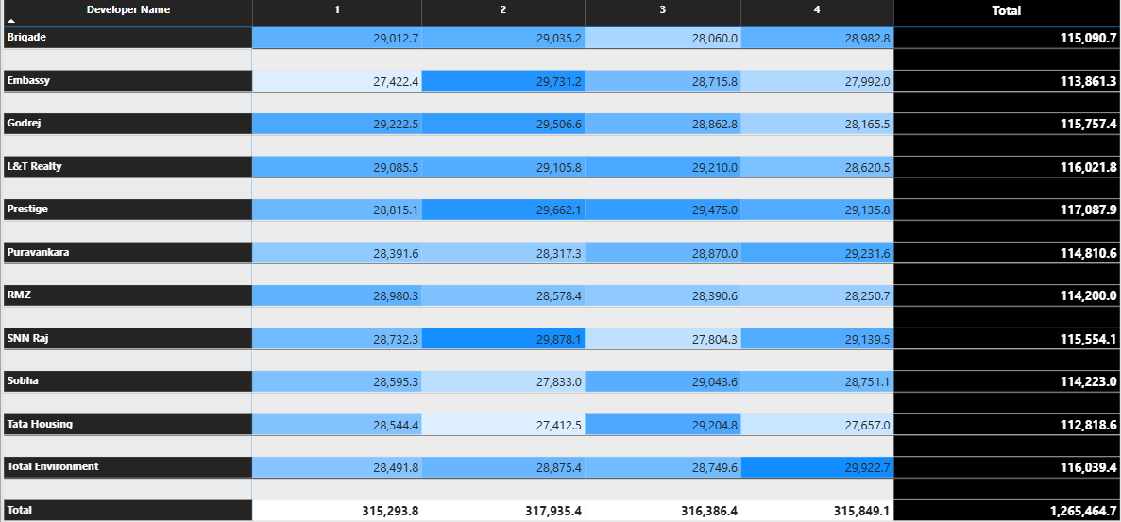
Quarterly Builder Contribution
Insights
Chart : Matrix Table
Rows : Developer Name
Column : Quarter Number
Value : Sum of Ticket Price Cr
Top Performer
Bottom Performer
Tata Housing
Lowest Total Revenue: 112,818.6Cr across all four quarters.
Q4 Dominator
Total Environment
Highest Q4 Revenue: 29,922.7Cr.
L&T Realty
Shows the smallest variance between its peak and trough, indicating highly stable quarterly sales.
Most Consistent
Embassy
showing the largest swing (2,308.8Cr) between its peak (29,731.2Cr) and trough (27,422.4Cr).
Prestige
Highest Total Revenue: 117,087.9Cr across all four quarters.
Highest Volatility

Slide 12
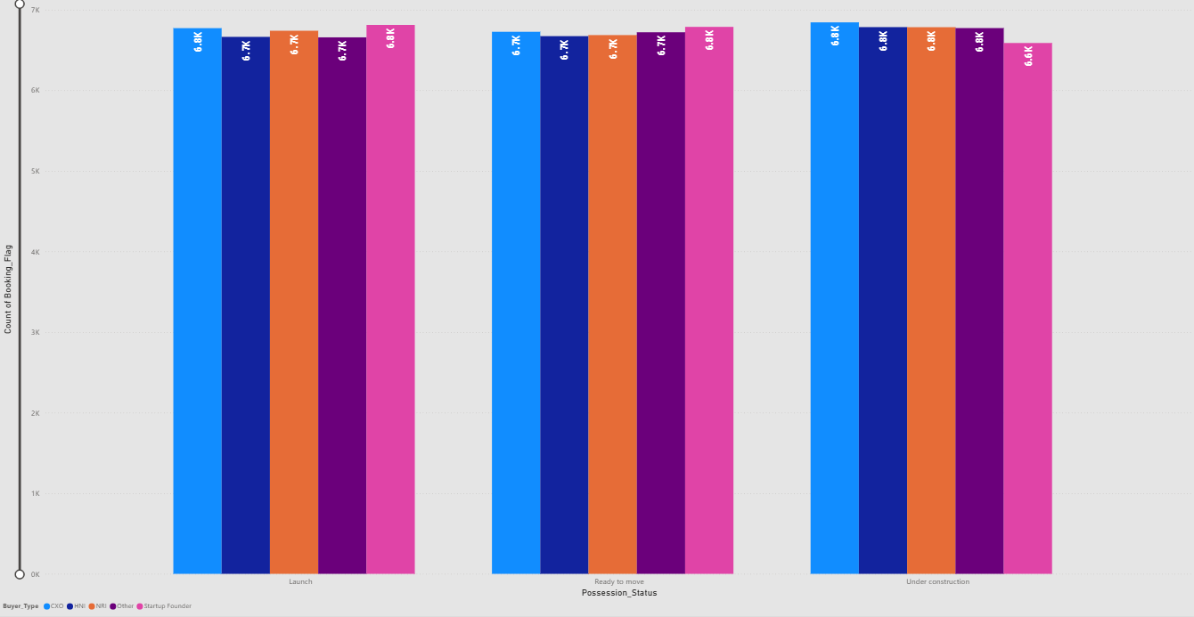
Possession Status Analysis
Insights
Chart : Clustered Column Chart
X axis : Possession_Status
Y axis : Count of booking flag
Legend : Buyer_type
Tool tips: Total_Revenue
Highest Revenue Status
Booking count is highly consistent across all possession statuses (≈33.6K - 33.7K).
Demand is robust across the project lifecycle; sales efforts should be maintained evenly across all stages.
While Under Construction leads revenue, the difference between the three statuses is minimal (≈2Cr).
Developers can achieve near-peak revenue at Launch and Ready to Move as well, allowing for flexible sales strategies.
Under Construction generates the highest total revenue at 422,835.49Cr with highest number of unit 33769
This stage is the most financially valuable overall, confirming that buyers commit the largest dollar value to projects with capital appreciation potential.
Volume Consistency
Investor Revenue Gap

Slide 13
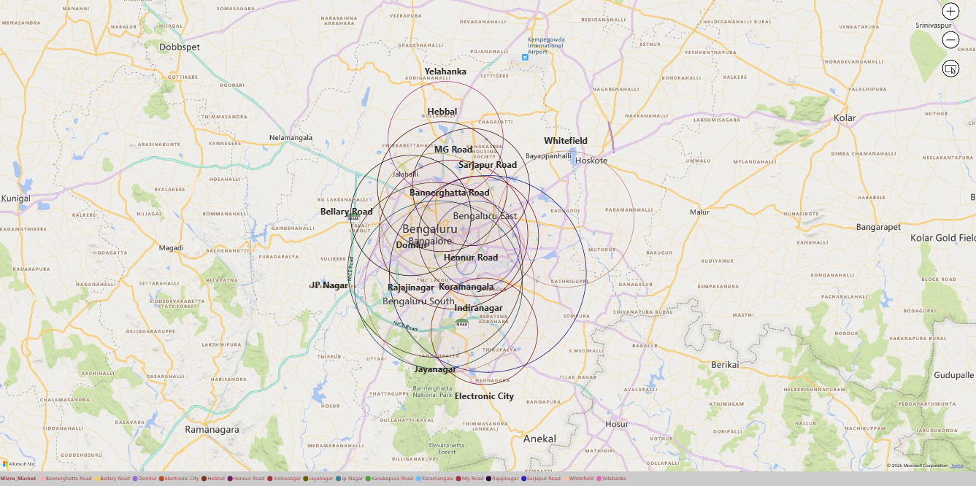
Geographical Insights
Insights
Chart : Map
Location : Place
Legend : Micro Market
Latitude : Latitude
Longitude : Longitude
Bubble size : Count of Developer Name
Tool tips : Total_Revenue
Top Revenue Driver
Sarjapur Road with 81,848.81Cr (6,435 Units)
Highest performing individual Place; prioritize future high-value projects here.
Market Concentration
Central-South East Corridor like Electronic City, JP Nagar, Sarjapur
Market is centered around established IT hubs / commercial
Central Region (Bannerghatta Rd., Domlur, Hennur)
Overlap on Map, Most intensely competitive
Highest Concentration
Yelahanka (North), Whitefield (East), Electronic City (South)
Less Overlap, growth opportunities for developers
Low Concentration

Slide 14
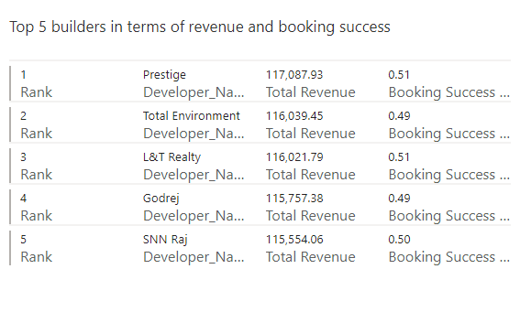
Top Performers
Insights
Chart : Multi-row card
Field : Rank, Developer Name, Total
Revenue, Booking success rate
Filter : Rank is less than equal to 5
Rank 1 ( Volume )
Prestige with 51% success rate achieves both the highest revenue and efficiency, superior performance across volume and conversion.
Prestige with 117,087.93 Cr is Highest total revenue, establishing them as the market volume leader.
Highest Efficiency
Total Environment and Godrej with (49%)
with high revenue ≈116K Cr but slightly less efficient (2% lower success rate) less than leaders.
Volume vs. Efficiency
SNN Raj with 50% success rate, Achieves a perfectly balanced 50% success rate while rounding out the top 5 by revenue.
Mid-Range Efficiency

Slide 15
THANKS YOU

